Slide 1
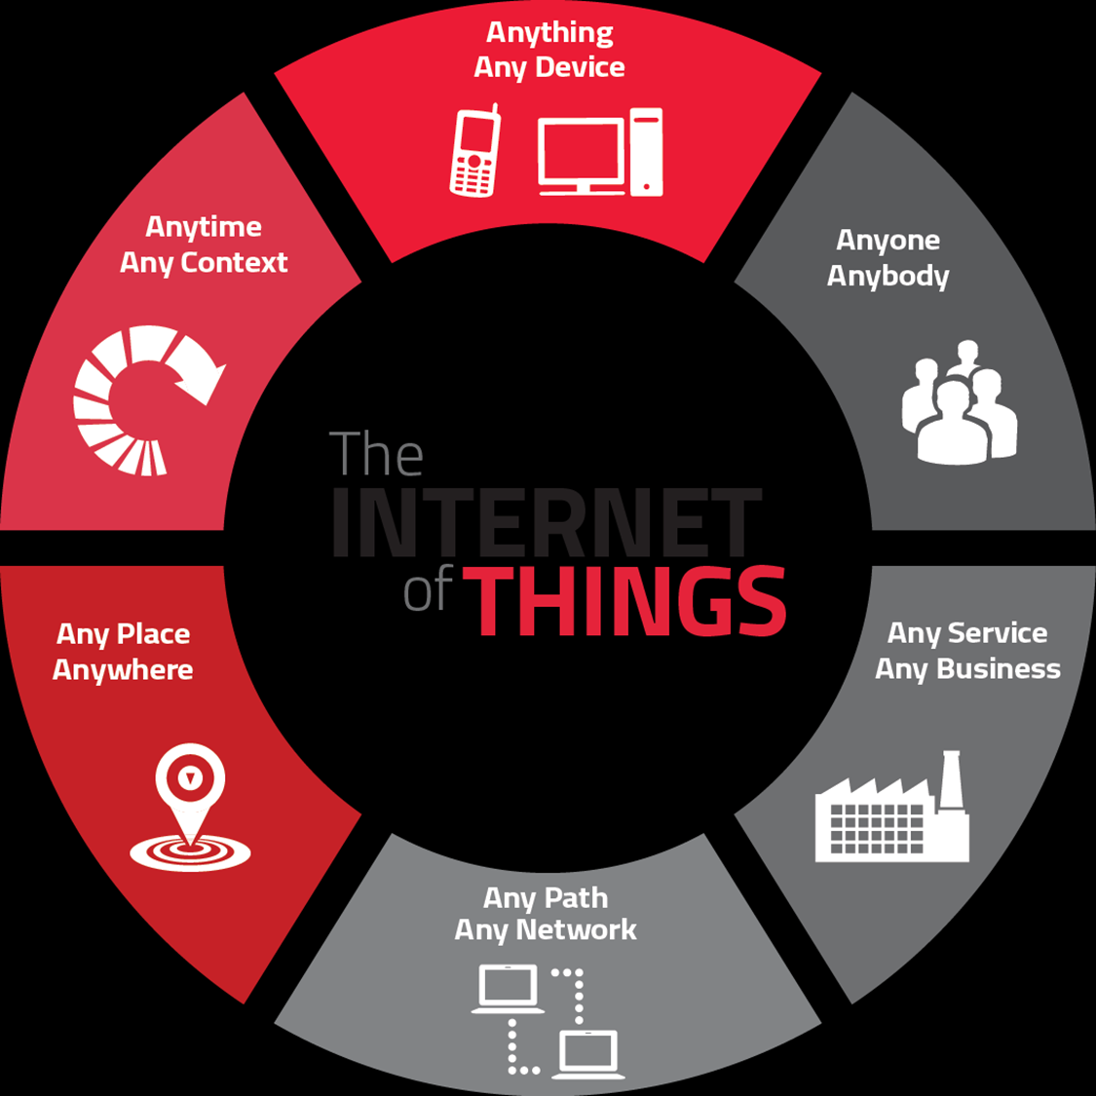
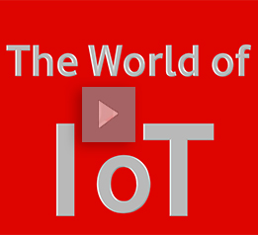
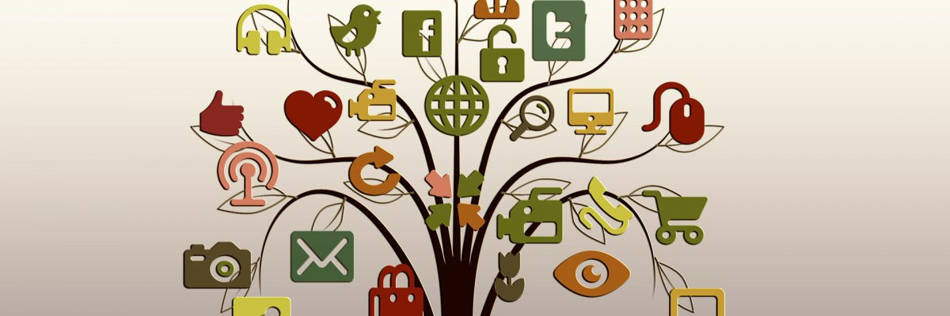

Slide 2
Plan of Presentation
What is Internet of Things?
History of IoT
How IoT Works?
Current Status & Future Prospect of IoT
The Future of IoT
Few Applications of IoT
Criticisms & Controversies of IoT
Summary
2

Slide 3

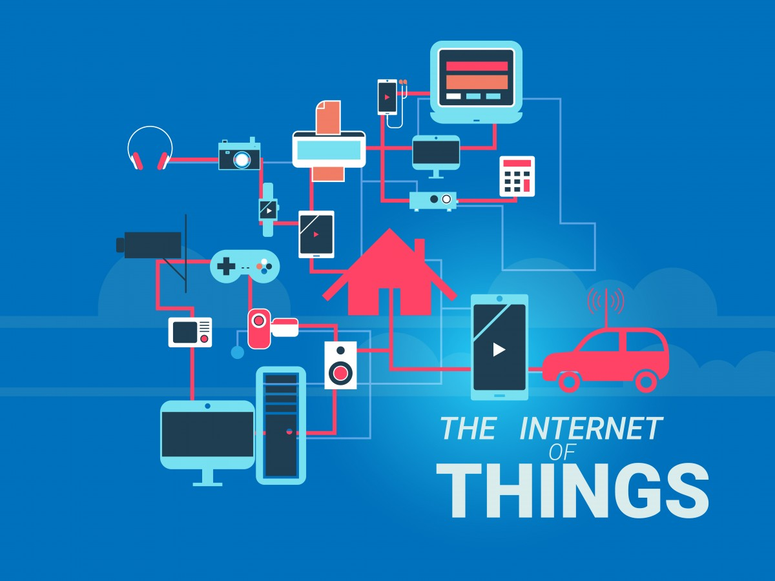
DEFINITION
The Internet of things (IoT) is the network of physical devices, vehicles, home appliances, and other items embedded with electronics, software, sensors and network connectivity which enable these objects to connect and exchange data

Slide 4

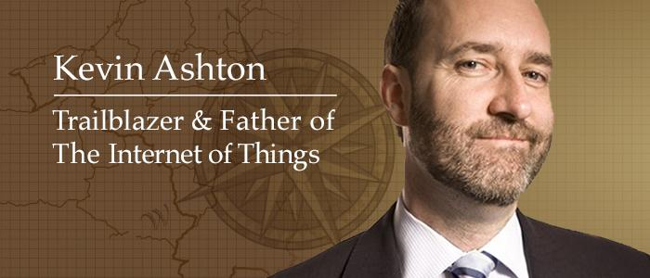
The Internet of Things (IoT) has not been around for very long. However, there have been visions of machines communicating with one another since the early 1800s. The Internet of Things, as a concept, wasn’t officially named until 1999.
Kevin Ashton, the Executive Director of Auto-ID Labs at MIT, was the first to describe the Internet of Things.

Slide 5
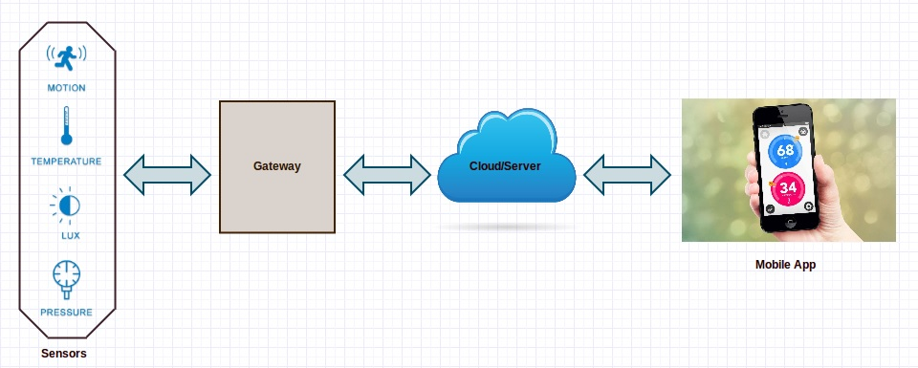
How an IoT System Actually Works?
A complete IoT system integrates four distinct components:
1.Sensors
2. Connectivity
3. Data processing
4.User interface.

Slide 6

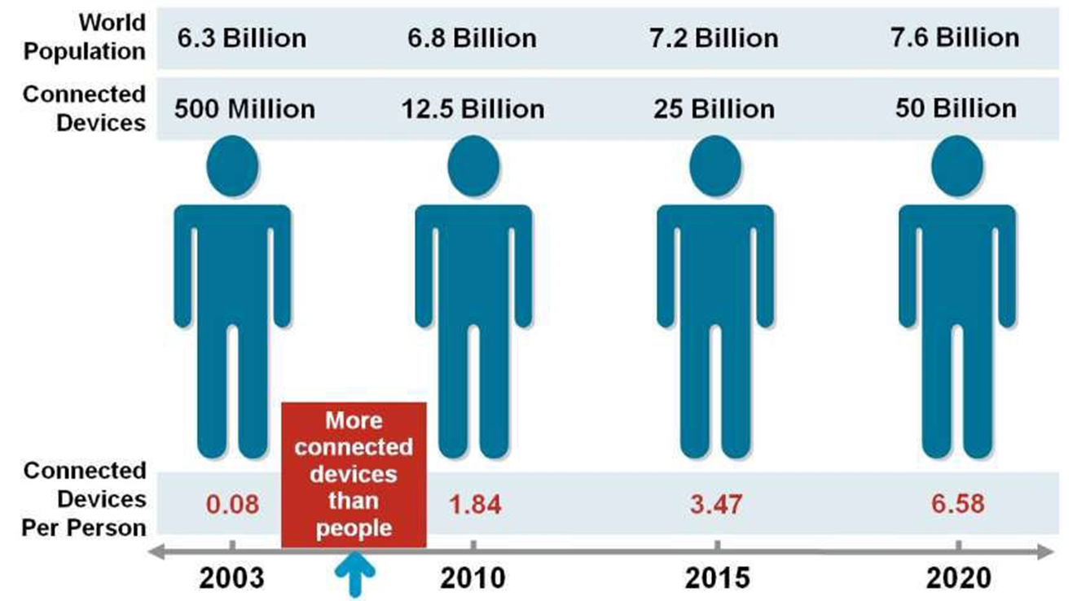

Slide 7
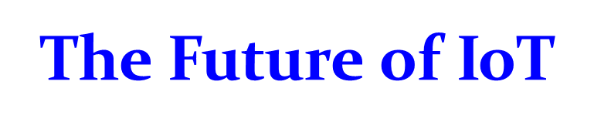
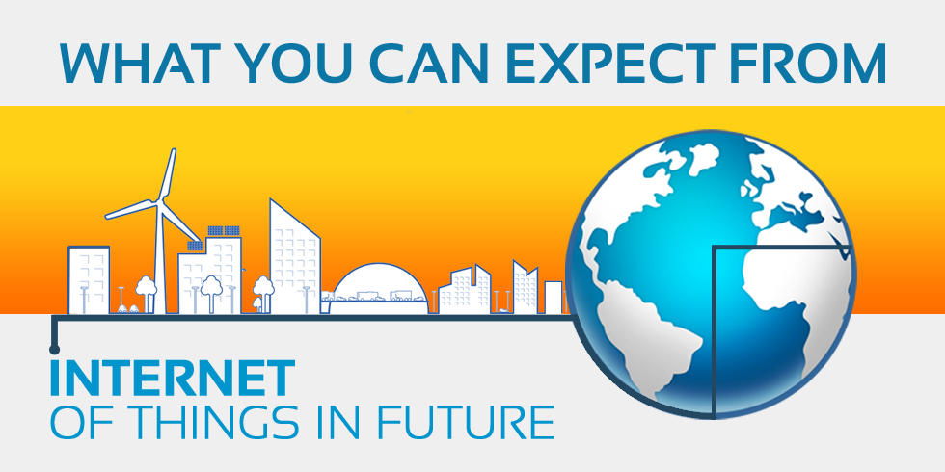

Slide 8
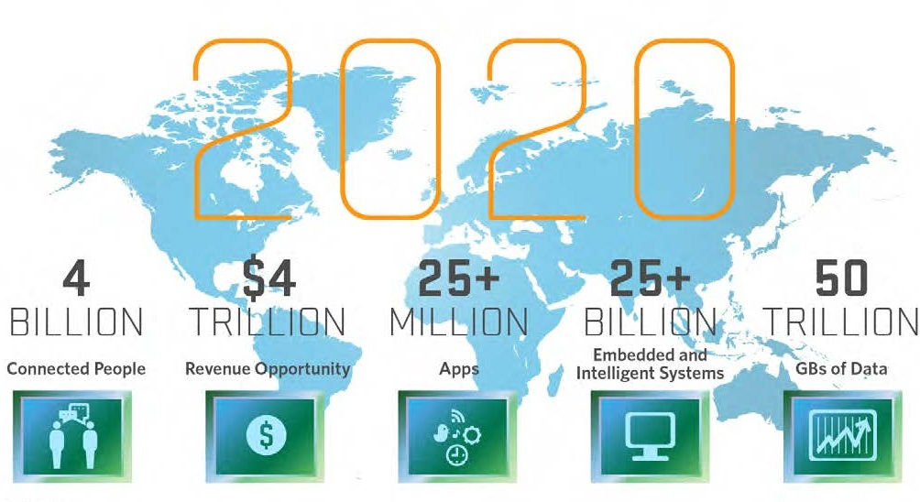

Slide 9

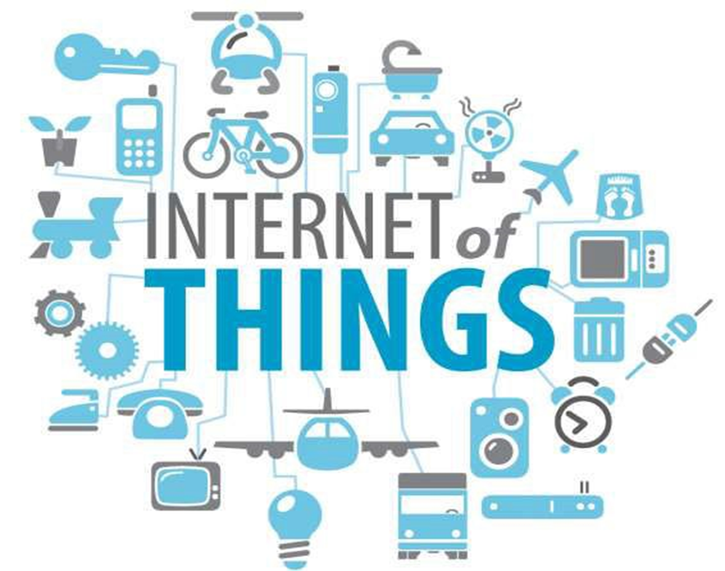

Slide 10
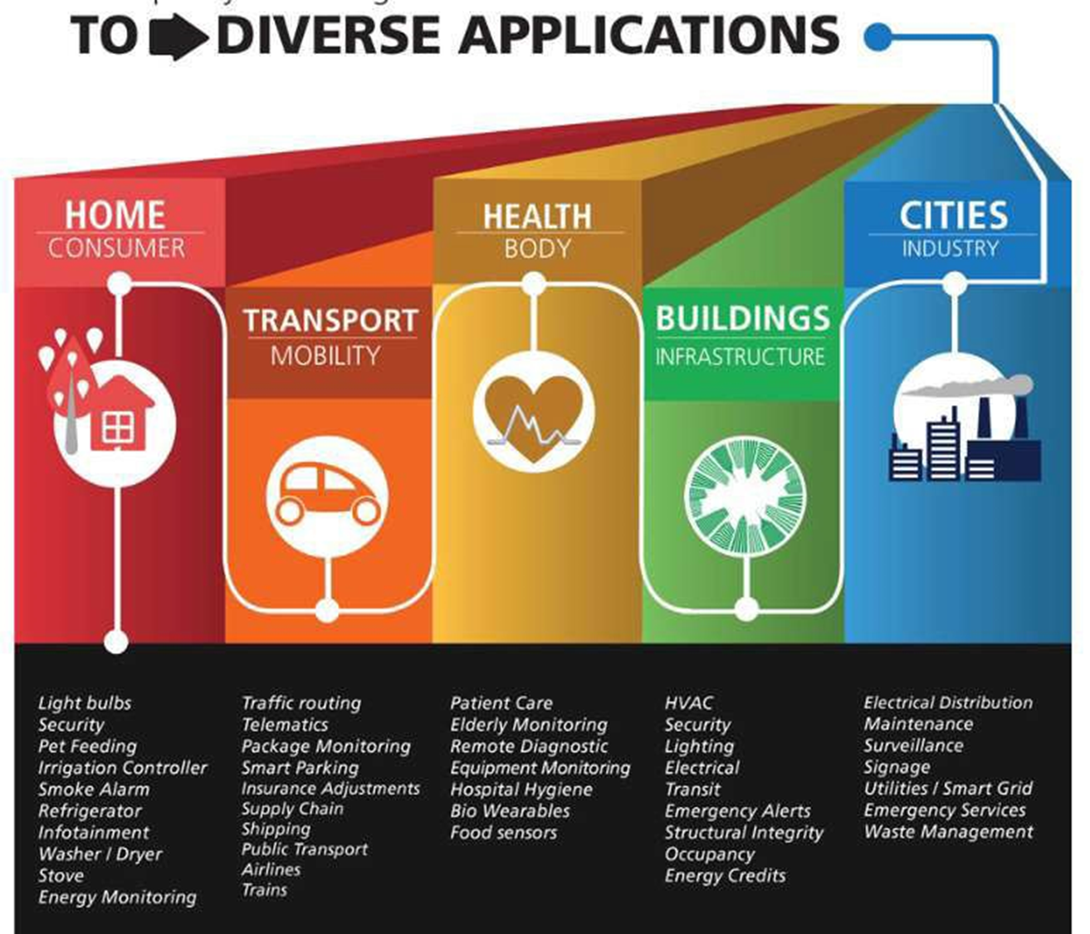

Slide 11
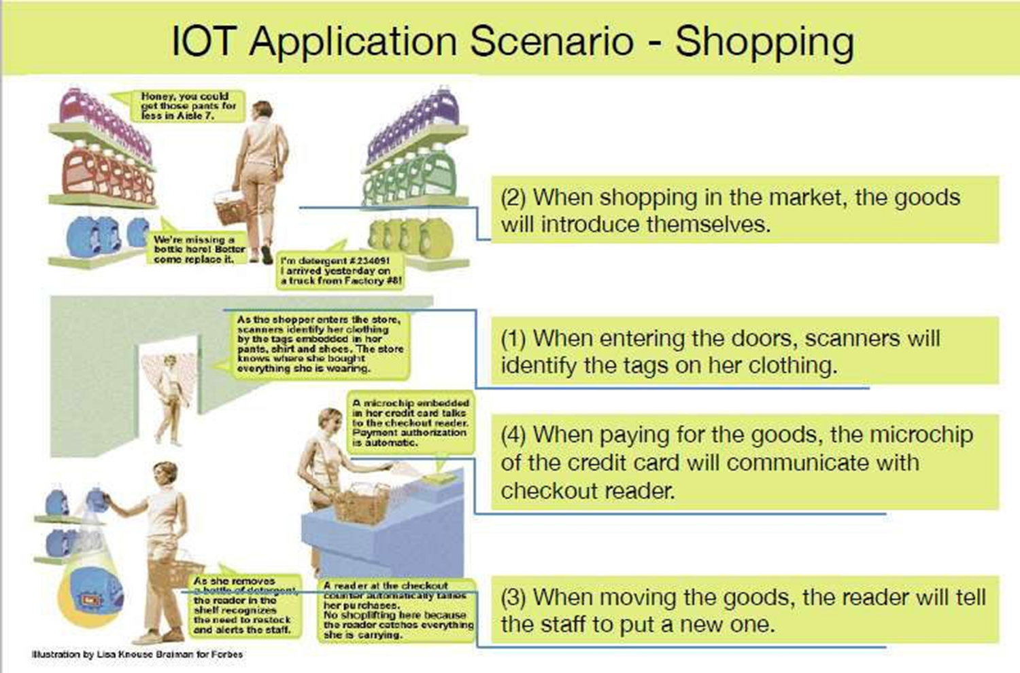

Slide 12


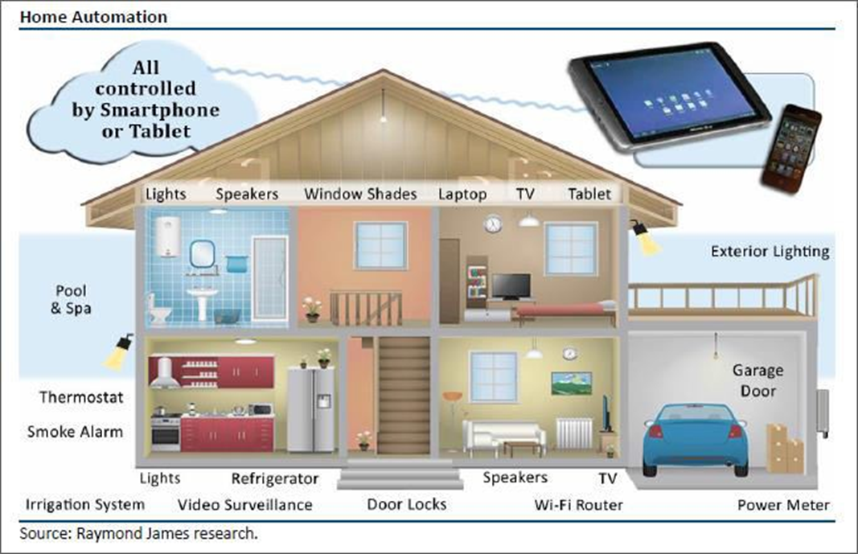
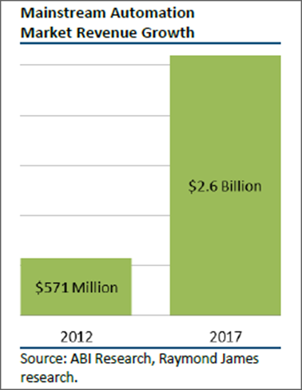

Slide 13

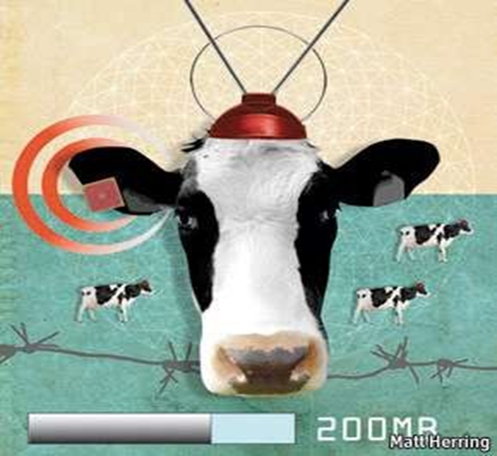
In the world of IoT, even the cows will be connected and monitored. Sensors are implanted in the ears of cattle. This allows farmers to monitor cows’ health and track their movements, ensuring a healthier, more plentiful supply of milk and meat for people to consume. On average, each cow generates about 200 MB of information per year

Slide 14


Slide 15
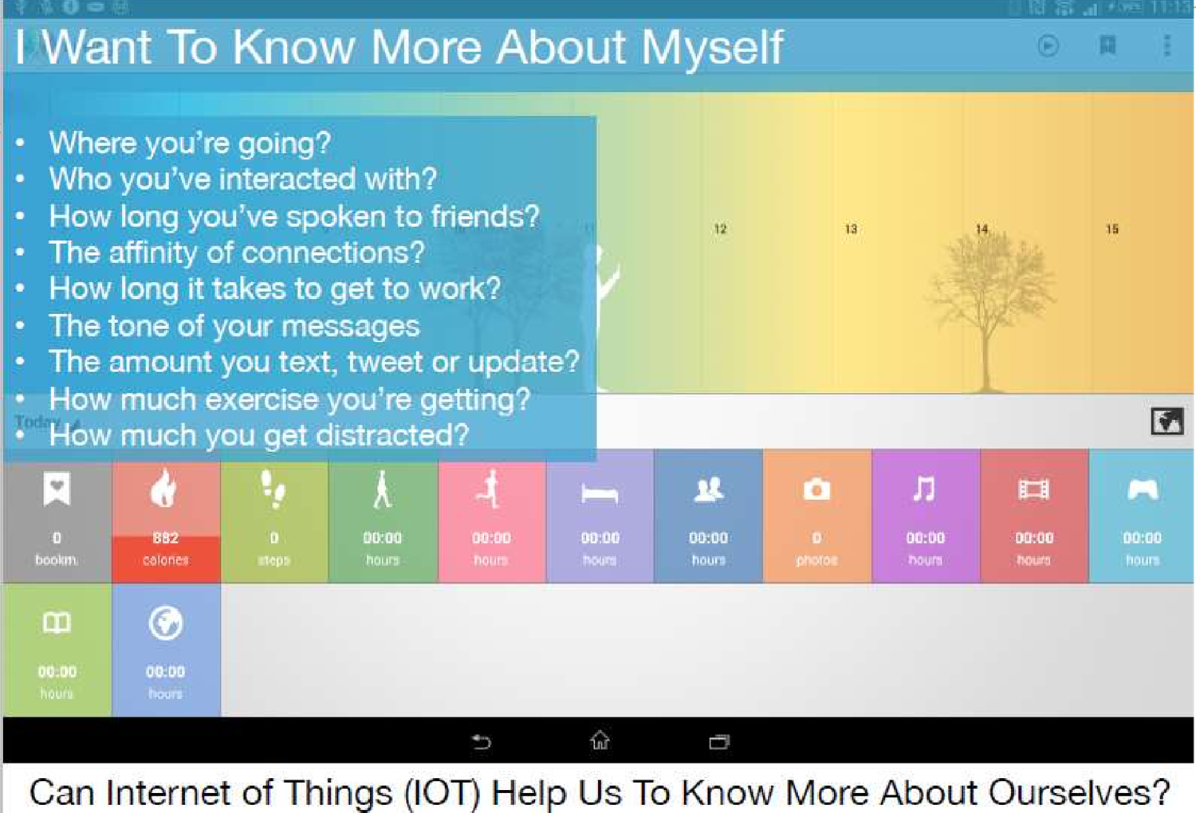
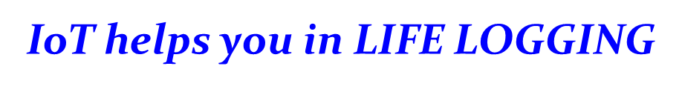

Slide 16

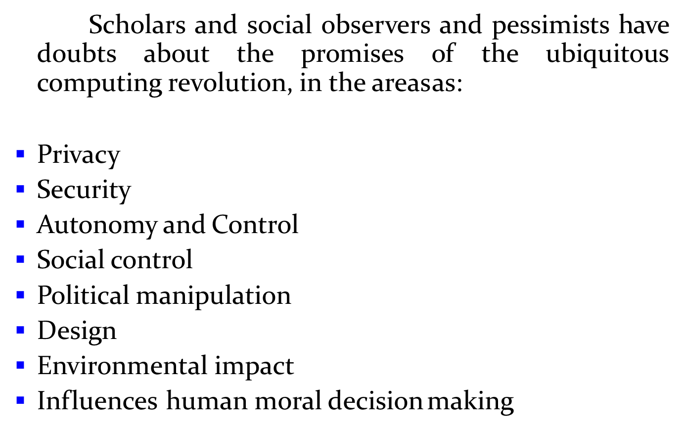

Slide 17
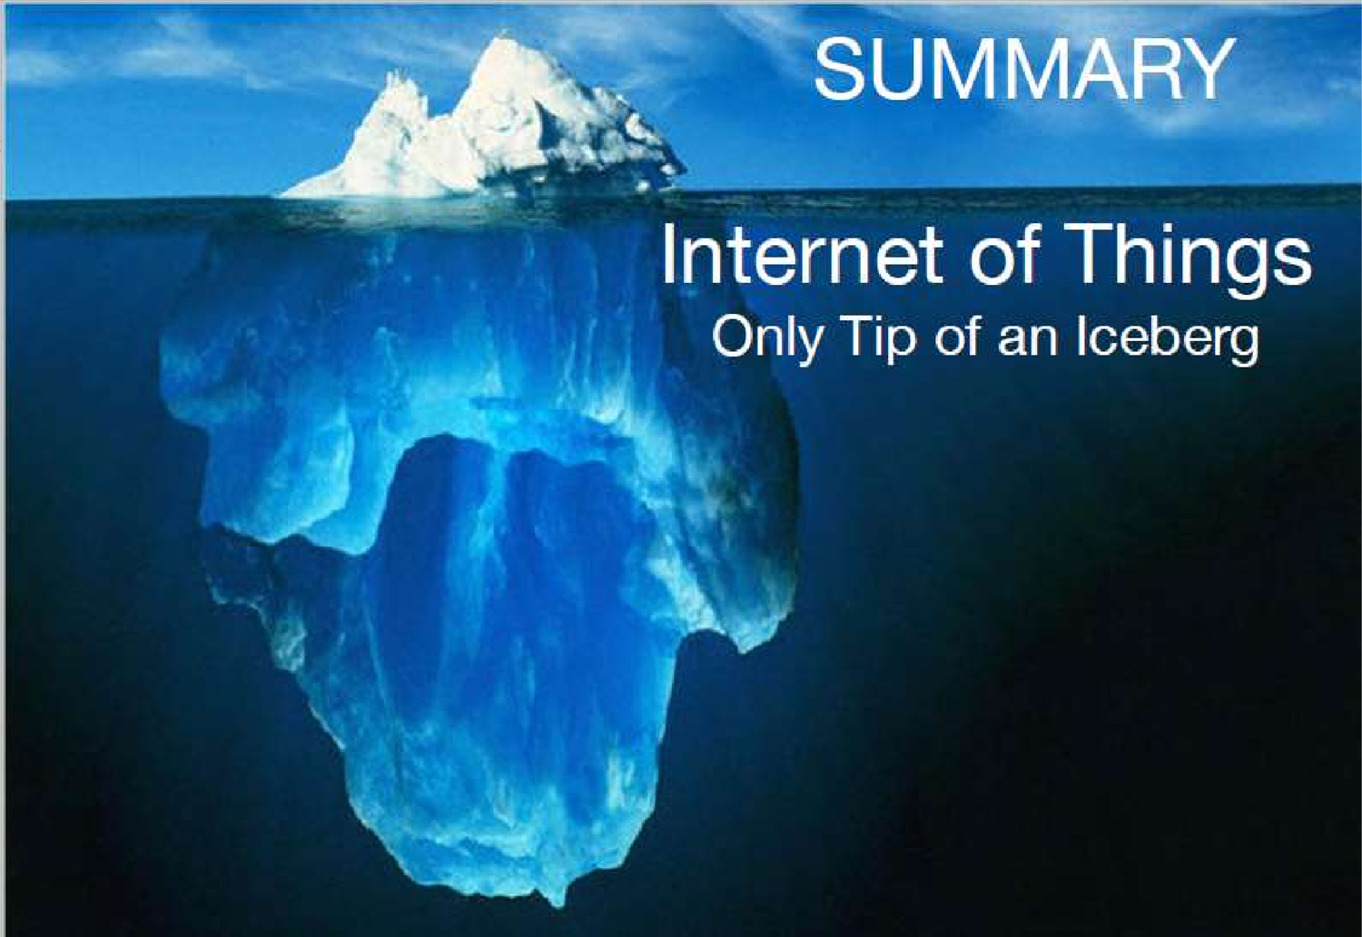

Slide 18


